Slide 1
Using For-Loops in R for Data Processing
Jing Feng
Sr. Institutional Researcher, Office of Institutional Analytics
April 18th, 2025

Slide 2
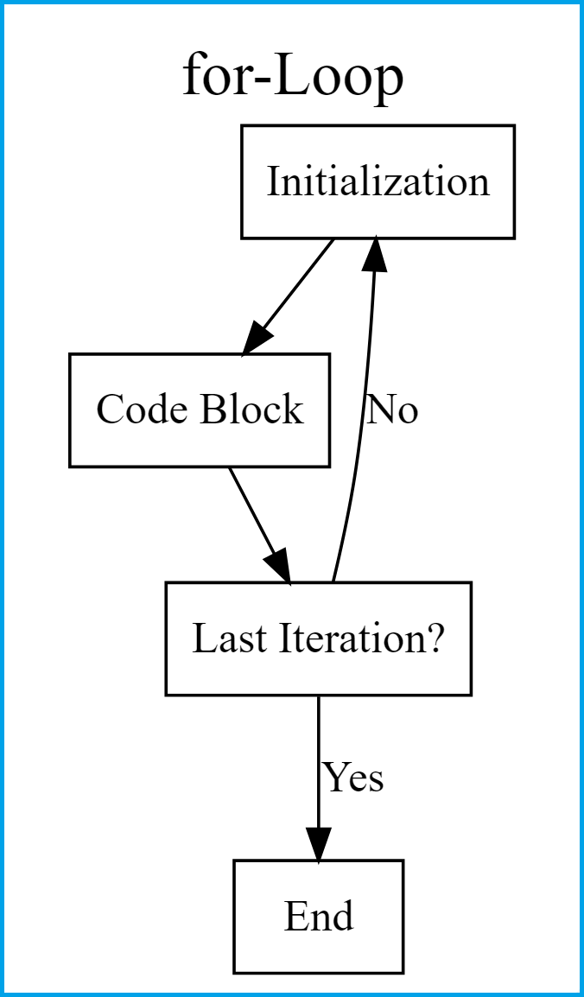
For-Loops
A for-loop iterates over a list of elements and executes statements in the code block, until it reaches the end of the list.

Slide 3
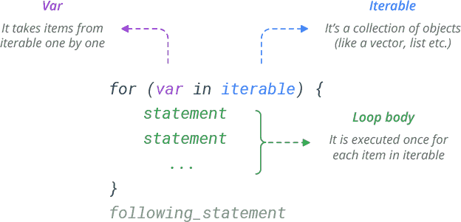
Syntax of For-Loops in R

Slide 4
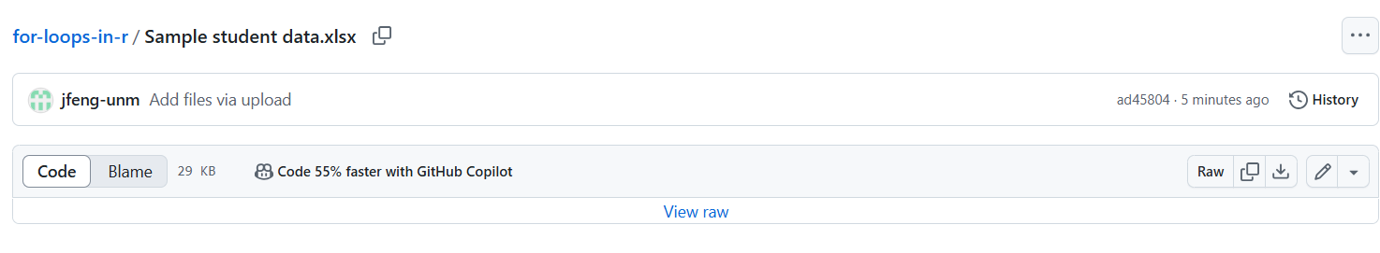
Demo/Exercise
Download Sample student data.xlsx here (either URL is okay):
https://github.com/jfeng-unm/for-loops-in-r
https://tinyurl.com/for-loop-r
Click on the file name, and then click on the download icon

Slide 5
Demo/Exercise
Save the Excel file on your computer, and import the it in R
Use a for-loop to iterate over one of the variables (campus, level or major) and perform tasks of your choice in the statement block

Slide 6
For-Loops debugging tips
Add print() statements to see what the code is doing in each iteration and where errors occur
Set the variable as a specific value, and only run the statements inside the loop body to see how they work.
e.g. If the loops starts with “for(x in 1:10)”, set x <- 1, and go inside the {} to run the statements line by line.

Slide 7
Resources
Online tutorials:
https://www.dataquest.io/blog/for-loop-in-r/
https://www.datacamp.com/tutorial/tutorial-on-loops-in-r
GitHub repo with R code and data file: https://github.com/jfeng-unm/for-loops-in-r
My email: jingfeng@unm.edu

Slide 8

Questions?

